Slide 1
What is NetCDF ?
And what are its plans for world domination?
John Caron
Unidata
August 2009

Slide 2
NetCDF is….
A file format
A library
An Application Programmer’s Interface (API)
A data model
A dessert topping
A floor wax

Slide 3
In the beginning
Application
C
IDL
Ruby
Matlab
C++
Fortran
Perl
Python
API
API
API
API
API
API
API
netCDF C library / API
netCDF file

Slide 4
Things got more complicated
Application
C
Python
Ruby
Matlab
C++
Fortran
Perl
Java
API
API
API
API
API
API
netCDF C library / API
netCDF Java library / API
netCDF-4 file
netCDF-3 file
OPeNDAP data

Slide 5
But wait, there’s more!
Scientific Feature Types
Application
Datatype Adapter
NetcdfDataset
NetCDF-Java/
CDM architecture
CoordSystem Builder
NetcdfFile
THREDDS
I/O service provider
Catalog.xml
OPeNDAP
NetCDF-3
NIDS
NcML
NetCDF-4
GRIB
HDF4
GINI
Nexrad
DMSP
…

Slide 6
Netcdf-Java 4.0 File Formats
General: NetCDF-3, NetCDF-4, HDF5, HDF4, OPeNDAP
Gridded: GRIB-1, GRIB-2, GEMPAK, McIDAS, UAMIV CAMx
Point: BUFR, GEMPAK
Radar: NEXRAD 2&3, DORADE, CINRAD, UF
Satellite: DMSP, GINI, McIDAS, FYSAT
Misc: GTOPO, NLDN, USPLN, etc
Notes:
Diversity of formats:

Slide 7
What is netCDF ?
Application
C
Python
Ruby
Matlab
C++
Fortran
Perl
Java
API
API
API
API
API
API
netCDF C library
netCDF Java library
NetcdfFile
I/O service provider
OPeNDAP
NetCDF-3
NIDS
netCDF-4 file
netCDF-3 file
OPeNDAP data
NetCDF-4
GRIB
HDF4
GINI
Nexrad
DMSP
…

Slide 8
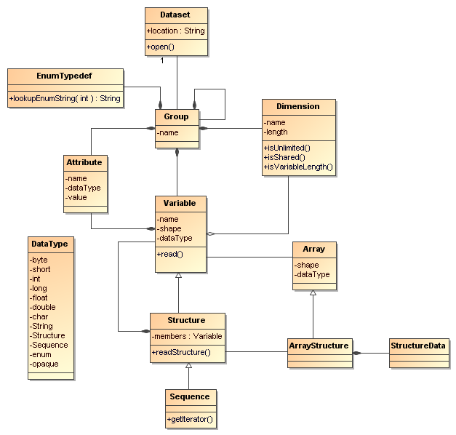
NetCDF is a…
File format
Store data model objects
Persistence layer
NetCDF-3, netCDF-4
Software library
Implements the API
C, Java, others
API
An API is the interface to the Data Model
for a specific programming language
An Abstract Data Model describes data objects
and what methods you can use on them

Slide 9
Storage Formats
NetCDF is an out-of memory Storage format
  So is a Relational Database (RDBMS)
I/O efficiency is measured in # disk accesses
  Sequential access is 100x faster than random
  Local disk, NFS mounted (shared), server RAID
The File System component of your OS is doing all kinds of complex caching for you
Application can try to optimize file layout within limits (write, read, common access patterns)
Only matters for very large I/O bound apps

Slide 10
NetCDF-3 file format
Header
Non-record
Variable
Variable 1
float var1(z, y, x)
Row-major order
Variable 2
Variable 3 …
Record Variables
float rvar1(0, z, y, x)
Record 0
float rvar2(0, z, y, x)
float rvar3(0, z, y, x)
Record 1…
float rvar1(1, z, y, x)
float rvar2(1, z, y, x)
float rvar3(1, z, y, x)

Slide 11
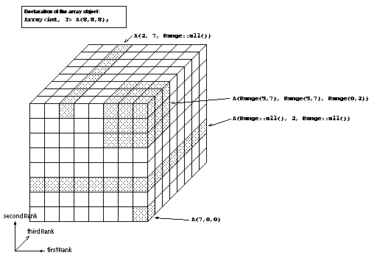
NetCDF-4 file format
Built on HDF-5
Much more complicated than netCDF-3
Storage efficiency
  Compression : can optimize chunking for common I/O pattern
  Compound types

Slide 12
Compound Types
Row vs col
Traditional RDBMS uses rows
Recent RDBMS research focusing on possible advantages with column oriented storage

Slide 13
NetCDF Libraries
NetCDF C library – reference implementation
  Read/write netCDF-3 and netCDF-4
  Read OPeNDAP (alpha)
NetCDF Java Library – experimental
  100% Java
  Read netCDF-3, netCDF-4, OPeNDAP, many others
  Only writes netCDF-3 (considering a JNI interface to C library for writing netCDF-4)
  Thread safe, good for servers, basis for the THREDDS Data Server (TDS)

Slide 14
Multicore CPUs
COTS CPU’s wont get any faster – too hot!
Moores Law -> multiple CPUs on chip
Multithreaded programs can take advantage of new multicore computer architecture
Good for servers, harder for client programs to take advantage of this

Slide 15
NetCDF APIs
Application Programmers Interface
  Its what you have to deal with
  Changing this breaks your code
Lots of language bindings, same data model
An API is the interface to the Data Model for a specific programming language

Slide 16
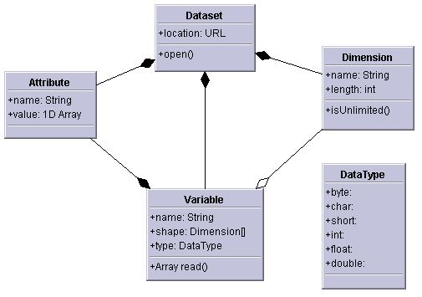
NetCDF-3 data model
Multidimensional arrays of primitive values
  Byte, char, short, int, float, double
Key/value attributes
Shared dimensions
Fortran77

Slide 17
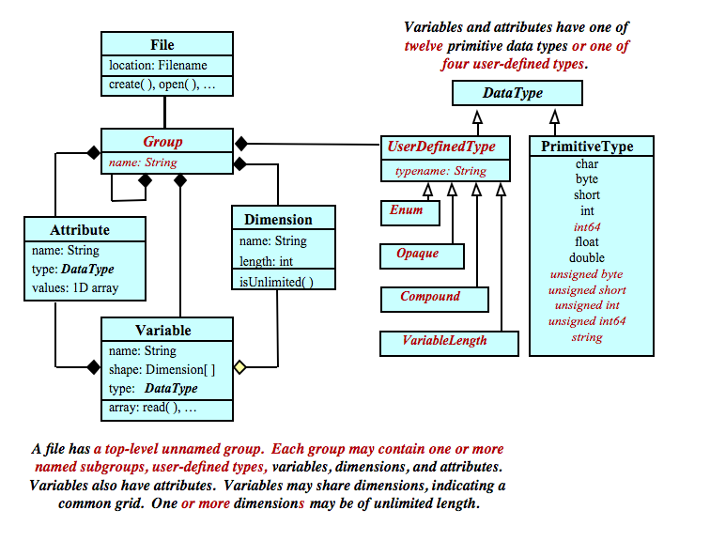
NetCDF-4 Data Model

Slide 18
NetCDF, HDF5, OPeNDAP
Data Models
Shared
dimensions
NetCDF (classic)
NetCDF (classic)
OPeNDAP
NetCDF (extended)
HDF5

Slide 19
Shared Dimensions
dimensions:
lat = 64;
lon = 128;
time= 72;
variables:
  float lat(lat);
  float lon(lon);
  float time(time);
  double temperature(time,lat,lon);
  coordinates=“lat lon time”;

Slide 20
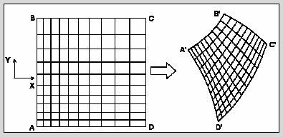
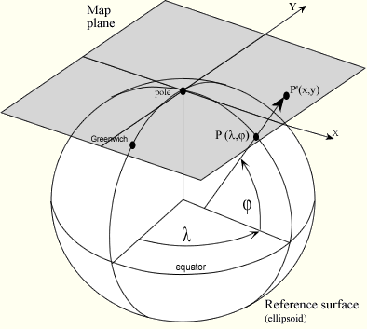
Gridded Data
Cartesian coordinates
Data is 2,3,4D
All dimensions have 1D coordinate variables (separable)
float gridData(t,z,y,x);
float t(t);
float y(y);
float x(x);
float z(z);
float lat(y,x);
float lon(y,x);
float height(t,z,y,x);

Slide 21
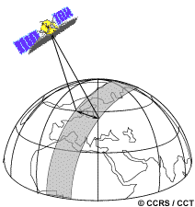
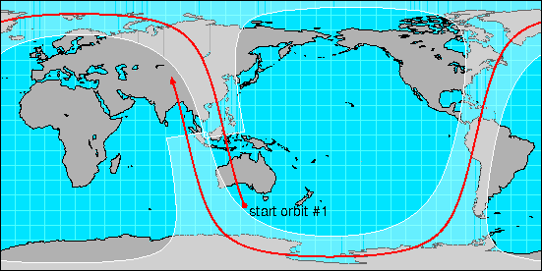
Swath
two dimensional
track and cross-track
not separate time dimension
orbit tracking allows fast search
float swathData( track, xtrack)
float lat(track, xtrack)
float lon(track, xtrack)
float alt(track, xtrack)
float time(track)

Slide 22
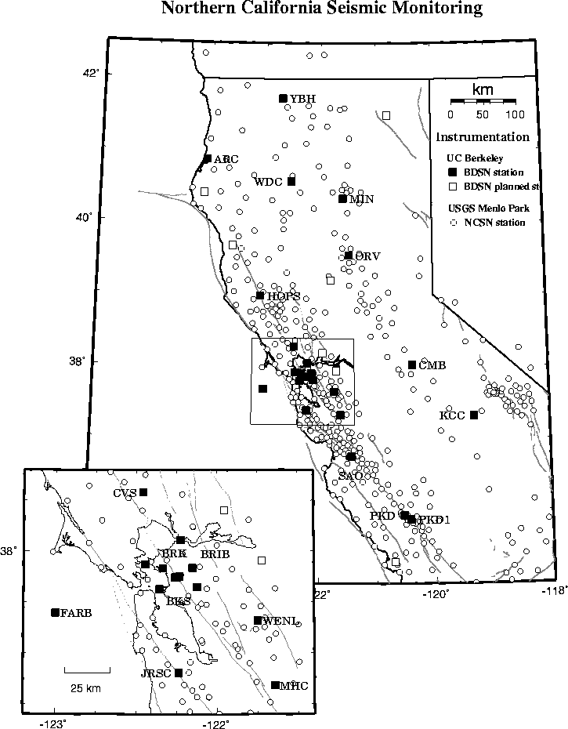
Point Observation Data
Set of measurements at the same point in space and time = obs
Collection of obs = dataset
Sample dimension not connected
float obs1(sample);
float obs2(sample);
float lat(sample);
float lon(sample);
float z(sample);
float time(sample);
Table {
lat, lon, z, time;
obs1, obs2, ...
} obs(sample);

Slide 23
Shared Dimensions Status
OPeNDAP
  Grids (special, but common case)
  Shared dimensions in DAP-4
HDF5
  Dimension Scales (special, but common case)
  HDF-EOS added shared dimensions in metadata
  NetCDF-4 adds a workaround
    NetCDF-4 not a subset of HDF-5
  NetCDF-4 does not (yet) read all HDF-5 objects
    HDF-5 not a subset of NetCDF-4

Slide 24
Back to API / Data Models
Scientific Feature Types
Application
Datatype Adapter
NetcdfDataset
NetCDF-Java/
CDM architecture
CoordSystem Builder
NetcdfFile
THREDDS
I/O service provider
Catalog.xml
OPeNDAP
NetCDF-3
NIDS
NcML
NetCDF-4
GRIB
HDF4
GINI
Nexrad
Data Access
DMSP
…

Slide 25
NetCDF “Index Space” Data Access:
  OPeNDAP URL:
  http://motherlode.ucar.edu:8080/thredds/dodsC/
  NAM_CONUS_80km_20081028_1200.grib1.ascii?
  Precipitable_water[5][5:1:30][0:1:77]
“Coordinate Space” Data Access:
  NCSS URL:
  http://motherlode.ucar.edu:8080/thredds/ncss/grid/
  NAM_CONUS_80km_20081028_1200.grib1?
  var=Precipitable_water&
  time=2008-10-28T12:00:00Z&
  north=40&south=22&west=-110&east=-80

Slide 26
Common Data Model
Scientific Feature Types
Point
Trajectory
Station
Profile
Radial
Grid
Swath
Coordinate Systems
Data Access
netCDF, HDF5, OPeNDAP
BUFR, GRIB1, GRIB2, NEXRAD, NIDS, McIDAS, GEMPAK, GINI, DMSP, HDF4, HDF-EOS, DORADE, GTOPO, ASCII,…

Slide 27
Common Data Model
3 layers

Slide 28
File Formats = Storage Strategy
Fortran77
opendap

Slide 29
API
What can I ask for?
What do I get back?

Slide 30

Higher Semantics

Slide 31
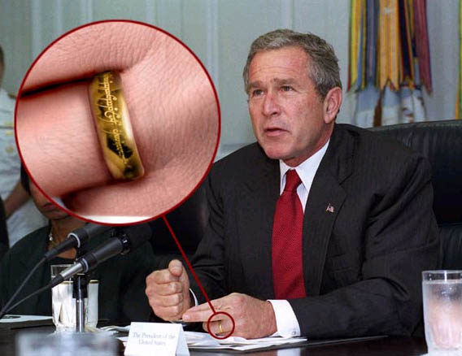
SQL

Slide 32
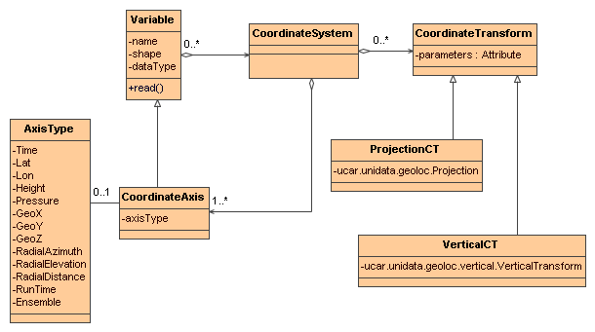
Next Steps

Slide 33
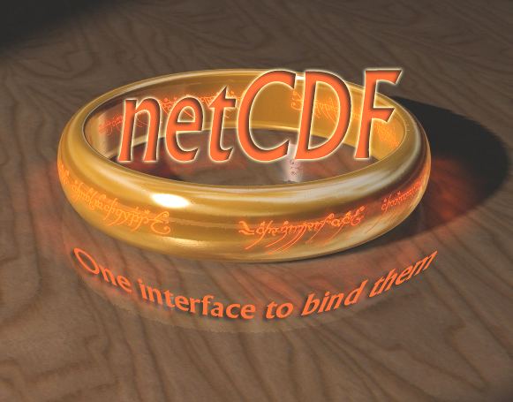

Slide 34
NetCDF-Java
Common Data Model
(Data Access Layer)

